Slide 1
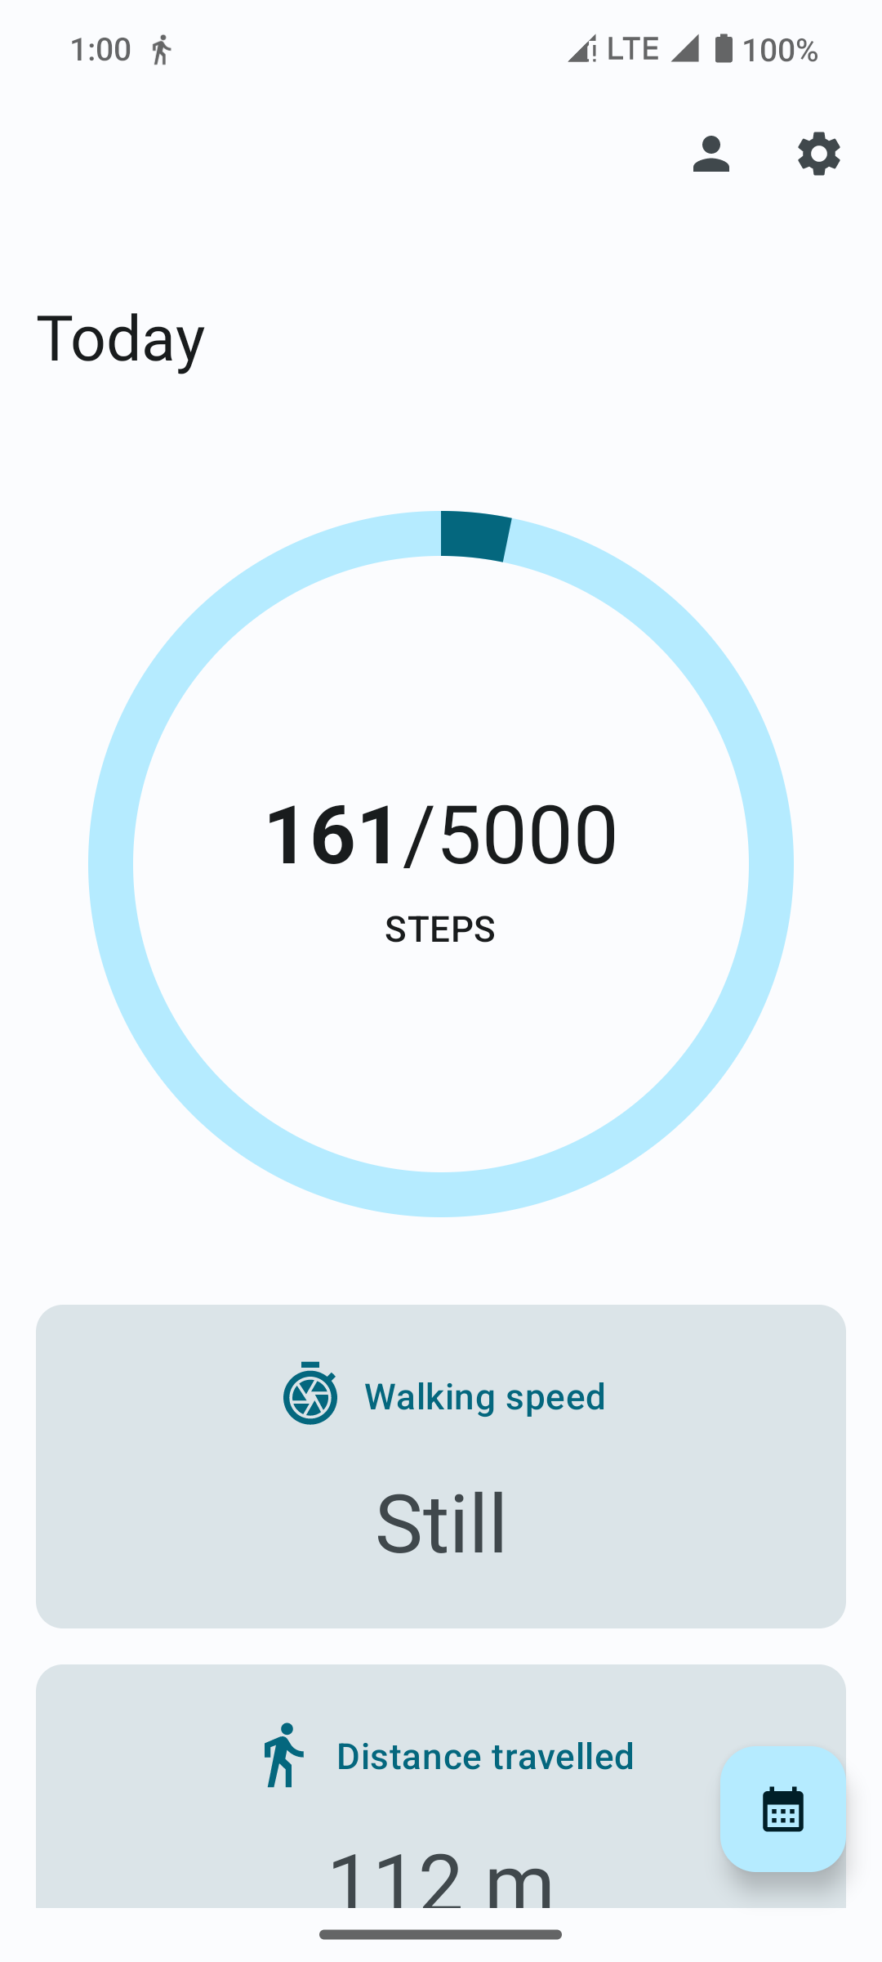
REAL-TIME STEP TRACKING APPLICATION
PRESENTED BY:
RAASHI PANT (56146)
HITESH KUMAR SAINI (56195)
SARTHAK RAWAT (56268)
PRIYANK SINGH (56787)
PRATIBHA (57189)
PROJECT GUIDE:
ER. ASHOK KUMAR
DEPARTMENT OF INFORMATION TECHNOLOGY
COLLEGE OF TECHNOLOGY, G. B. P. U. A. & T.
PANTNAGAR
GROUP 3

Slide 2
Table of contents
01
02
03
05
06
08
04
Introduction
Objective
Description
Features
07
Target Audience
Technologies Used
Implementation
Future Scope

Slide 3
Vision
In our increasingly fast-paced and technologically driven world, the need for a step tracking application has become more crucial than ever. The rapid shift towards sedentary lifestyles, characterized by long hours spent sitting at desks, engaging with screens, and limited physical activity, has raised concerns about the impact on our overall health and well-being.
The importance of maintaining an active lifestyle cannot be overstated, as regular physical activity is closely linked to various health benefits. This is where a step tracking application comes into play. By leveraging the devices, we already carry, such as smartphones , the application can provide a simple yet effective means of monitoring our daily step count. Tracking our steps serves as a tangible and measurable indicator of our physical activity levels, encouraging individuals to incorporate more movement into their daily routines.

Slide 4
Primary Goals
Step tracking
Current speed estimation
Accurately tracking steps taken by the user.
Estimate current walking/running speed as still, slow, medium or fast.
Distance travelled estimation
Calories burnt estimation
Estimate distance travelled by the user.
Estimate calories burnt based different parameters e.g. step count, speed, height, weight & gender of the user.

Slide 5
Project Objective
Empower users with data and insights: Help users understand their daily activity levels and calorie expenditure through accurate tracking and insightful analysis.
Promote active lifestyles: Motivate users to increase their daily steps and engage in activities that contribute to a healthy lifestyle.
Support weight management goals: Assist users in tracking their calories expenditure, aiding in weight management or fitness goals.

Slide 6
Project Features
Accurate Step Tracking
Current speed estimation
Calorie Burn Estimation
Distance Estimation
Using device’s sensor
Still, slow, medium or fast
Based on steps taken, height, weight, gender etc.
Overall travel distance
Real-Time
Updates
Set
Goals
Background
Processing
Weekly/Monthly Analytics
Immediate feedback
Daily step goal
Using foreground service
Distance travelled or calories burnt over week or month

Slide 7
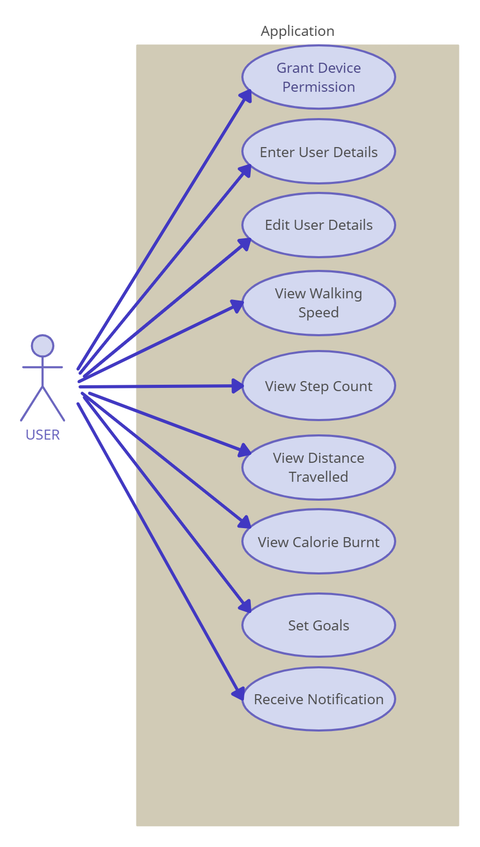
Use Case

Slide 8
Target Audience
Fitness Enthusiasts: People who are actively engaged in regular exercise and fitness routines, aiming to optimize their workouts and achieve specific health goals.
Athletes: Sports professionals and enthusiasts who want to track and analyze their training sessions for performance enhancement.
Health-Conscious Individuals: Those who prioritize overall health and wellness, seeking tools to monitor and improve their daily physical activity levels.
Seniors: Older adults who wish to maintain mobility, track daily activity, and ensure they meet recommended exercise levels for their age group.
Rehabilitation Patients: Individuals recovering from surgeries or injuries, working with healthcare professionals to gradually increase activity levels during rehabilitation.

Slide 9
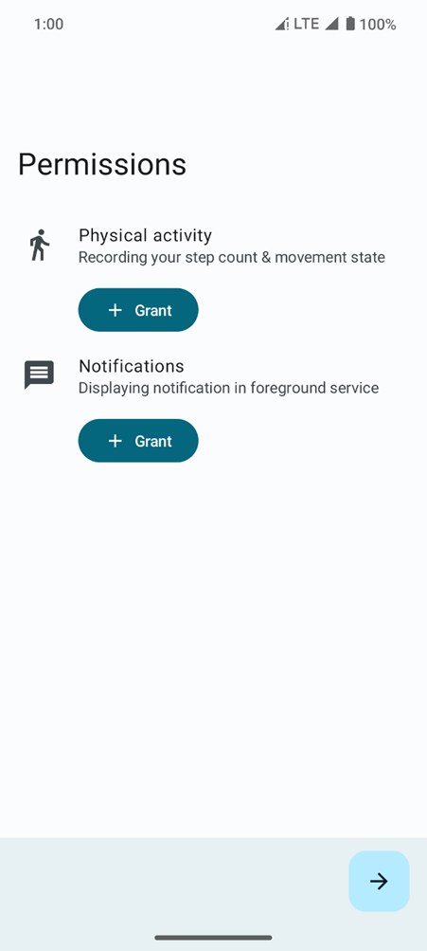
Functionalities
Permissions Screen
Manifest.permission.ACTIVITY_RECOGNITION
Manifest.permission.POST_NOTIFICATIONS

Slide 10
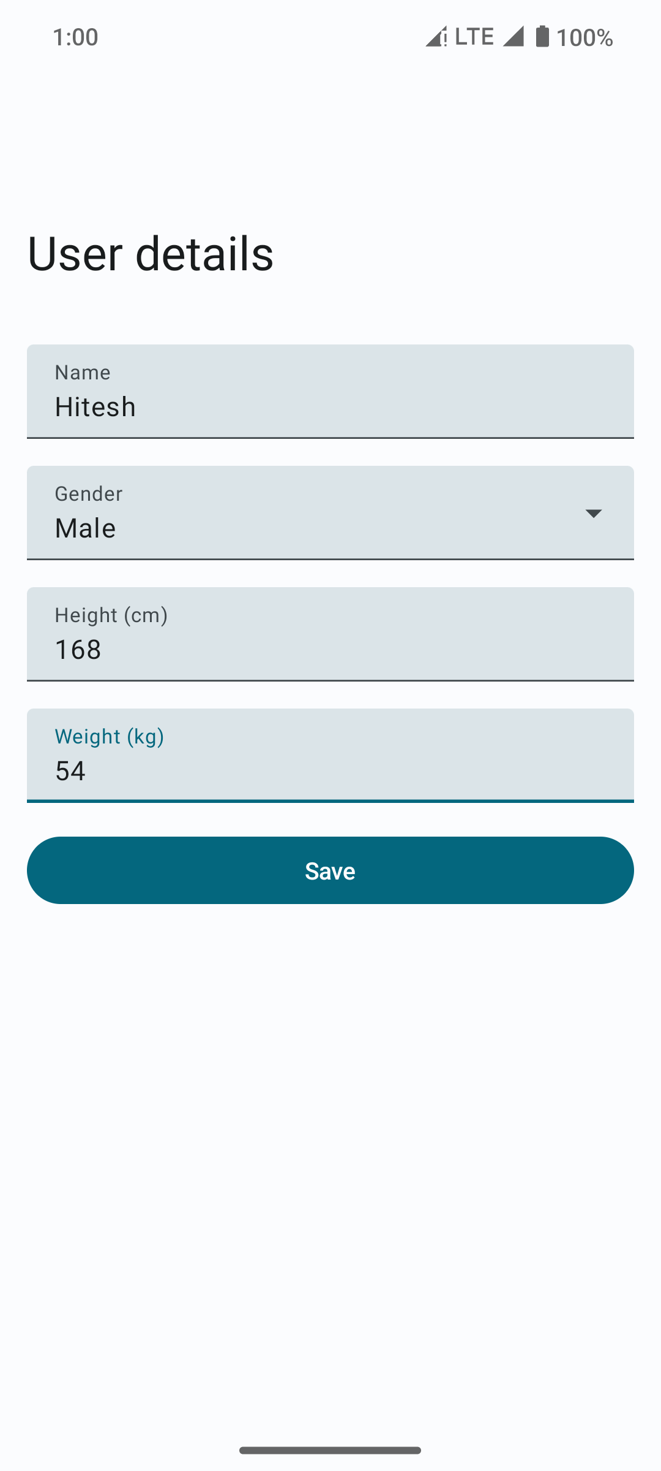
User Details Screen
Used to calculate different metrics

Slide 11
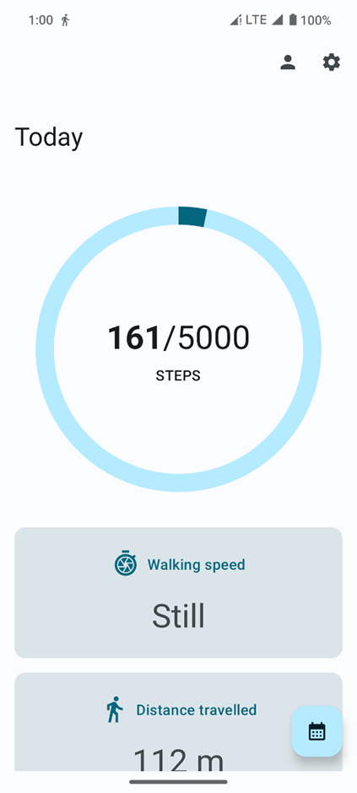
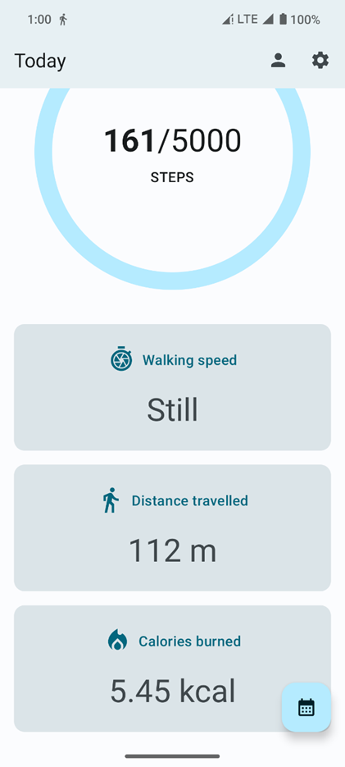
Home Screen

Slide 12
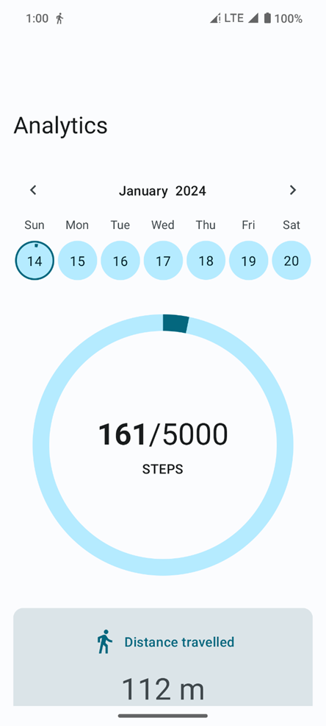
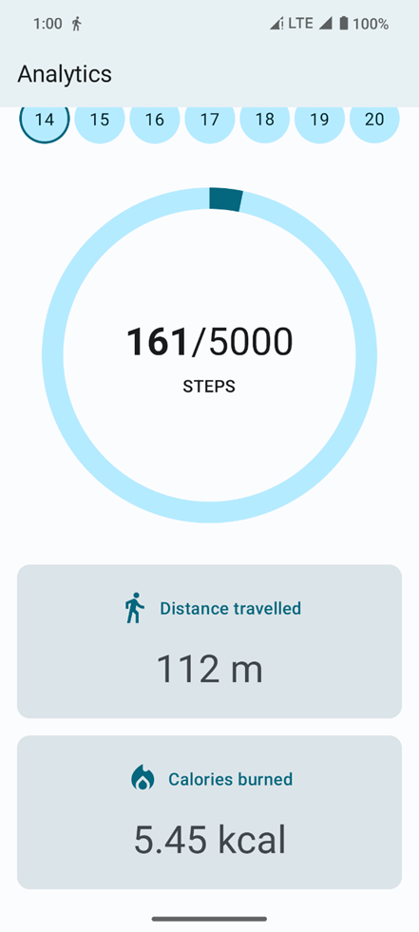
Analytics Screen

Slide 13
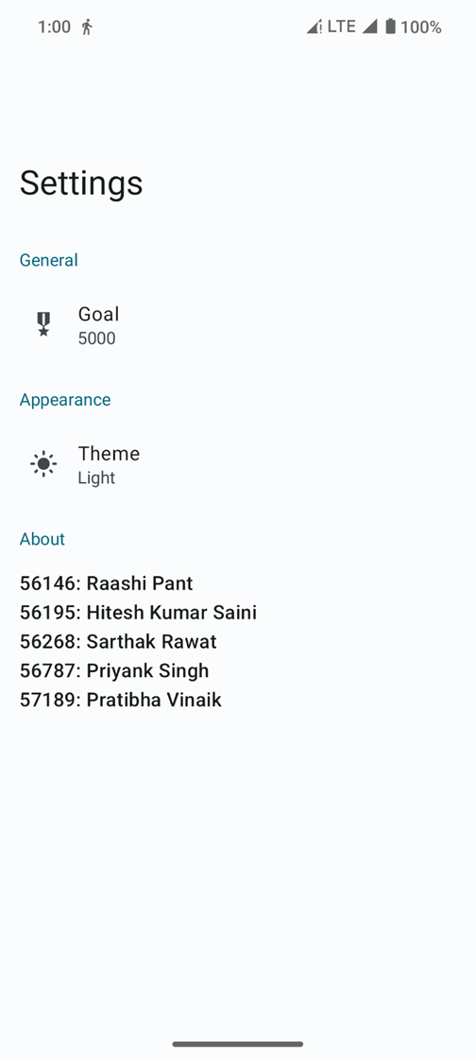
Settings Screen

Slide 14
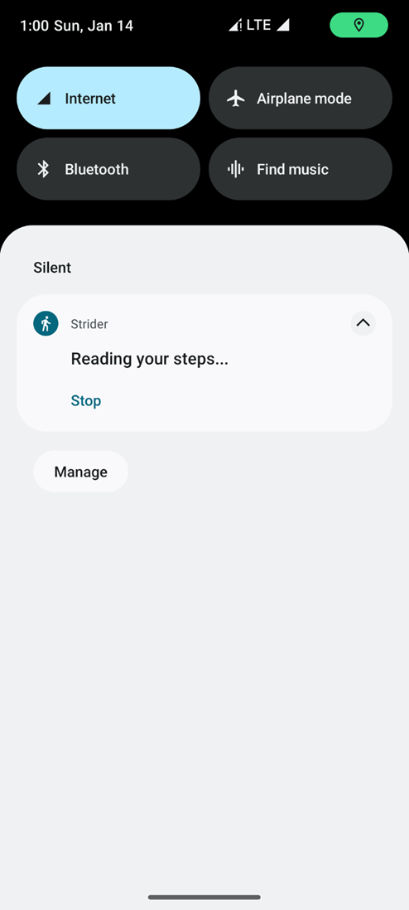
Background
Foreground service
Background service
Bound service

Slide 15


Technologies Used
Kotlin
Jetpack Compose
Android Architecture Components
Navigation Component
Room
Shared Preferences
Services
MVVM

Slide 16
Room
The Room persistence library provides an abstraction layer over SQLite.
Entity
DAO
Database
Part of Android Jetpack Suite.
Type Safe
Programmatic Access

Slide 17
Room: Entity
@Entity(
tableName = "Step",
primaryKeys = ["instant"],
indices = [Index("instant", "instant", [Index.Order.ASC, Index.Order.DESC], "instant", true)]
)
data class Step(
val instant: Instant,
val MET: Float,
val height: Float, /* cm */
val weight: Float, /* kg */
val speed: Float, /* m/s */
val walkSpeed: WalkSpeed
) : Serializable

Slide 18
Room: DAO
@Dao
interface StepDao {
@Insert()
fun insert(value: Step)
@Query("SELECT * FROM Step WHERE instant > :from AND instant <= :to")
fun getStepsInRange(from: Instant, to: Instant): List<Step>
@Query("SELECT COUNT(*) FROM Step WHERE instant > :from AND instant <= :to")
fun getStepCountInRange(from: Instant, to: Instant): Long }

Slide 19
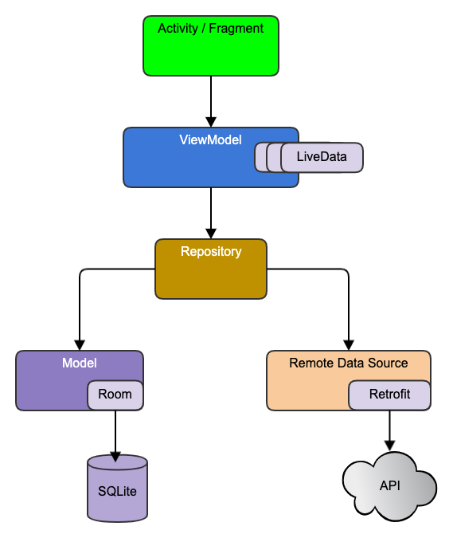
MVVM
Model View View-Model
Officially recommended architectural pattern for Android development.
Allows separation of concerns.
Allows separation of business logic from user-interface.

Slide 20
Implementation
User-Interface
Views
PermissionsScreen
UserDetailsScreen
HomeScreen
AnalyticsScreen
SettingsScreen
View Models
UserDetailsViewModel
StepViewModel
SettingsViewModel
Domain
Repository
UserDetailsRepository
StepRepository
SettingsRepository
Data
Model
Step
Database
StepDatabase
DAO
StepDao
Type Converters
InstantConverter

Slide 21
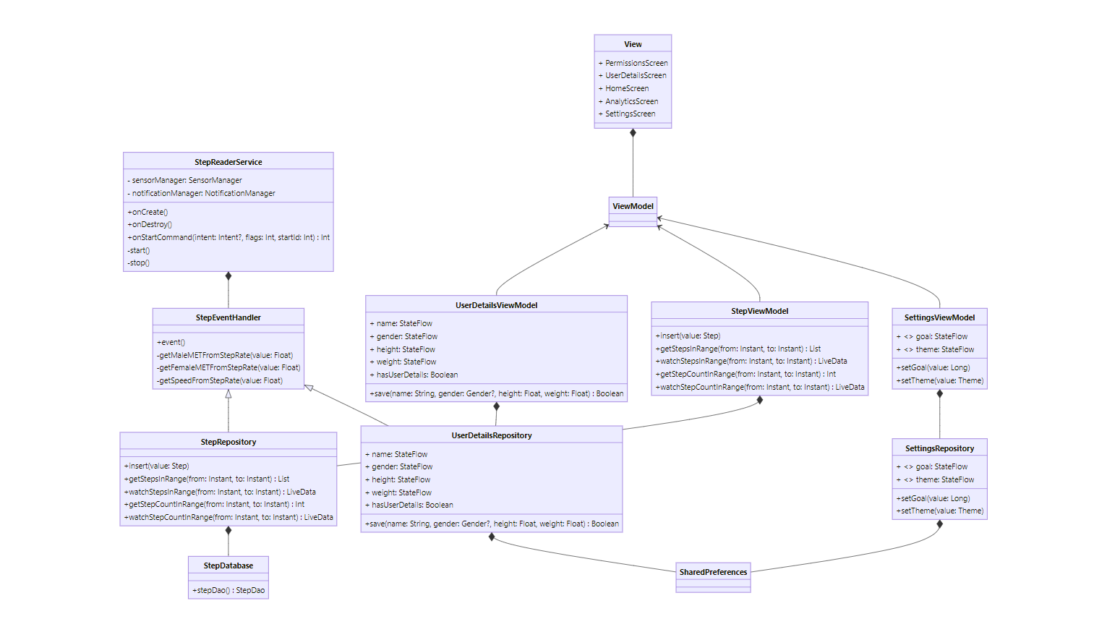
Implementation

Slide 22
Theory
The Android operating system offers a number of sensors such as:
• TYPE_ACCELEROMETER
• TYPE_GRAVITY
• TYPE_GYROSCOPE
• TYPE_PRESSURE
• TYPE_PROXIMITY
• TYPE_STEP_COUNTER
• TYPE_STEP_DETECTOR

Slide 23
Theory: Walking Speed
• If the step-rate (per-minute) is less than 135, it is identified as “slow”.
• If the step-rate (per-minute) is less than 160, it is identified as “medium”.
• If the step-rate (per-minute) is greater, it is identified as “fast”.
Additionally, a refractory period of 2 seconds is used to check if user has entered a “still” state i.e. a state of no movement.

Slide 24
Theory: Distance Travelled
The stride of an adult human is given by expression below:
stride = height × 0.414
It is used to calculate the distance travelled.

Slide 25
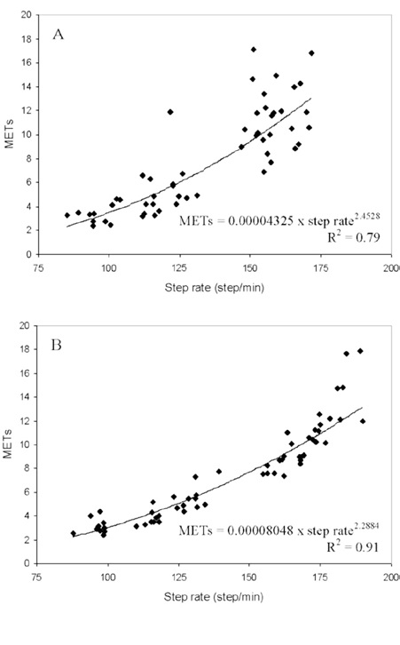
Theory: Calories Burnt
Each physical activity has it’s metabolic equivalent (MET).
Based on the observations from "Determination of step rate thresholds corresponding to physical activity classifications in adults", the relationship between MET & step rate (step/minute) is given by expression below:
For males:
MET = 0.00004325 × (step-rate) ^ 2.4528
For females:
MET = 0.00008048 × (step-rate) ^ 2.2884 distance = stride × steps
time = distance / speed
calories = time × MET × 3.5 × weight / (200 × 60)

Slide 26
Future Scope
Sync on remote database
Social features
A remote database will play a crucial role in ensuring seamless data synchronization across various platforms and devices. e. g. Firebase.
Enhancing the step-tracking application with social features involves creating a dynamic and interactive community within the platform.
Integration of Wearable Devices
Machine Learning for Predictive Analytics
This involves integrating with a broader range of wearable devices & fitness trackers to provide users with more choices and compatibility.
Implement machine learning algorithms to analyse user behaviour and patterns.

Slide 27
References
https://kotlinlang.org
https://developer.android.com/jetpack/compose
https://developer.android.com/jetpack/compose/navigation
https://developer.android.com/topic/architecture
https://developer.android.com/training/data-storage/room
https://developer.android.com/training/data-storage/shared-preferences
https://developer.android.com/develop/background-work/services
https://www.omnicalculator.com/sports/steps-to-calories
https://www.maine.gov/mdot/challengeme/topics/docs/2019/may/How-to-Walk-with-Proper-Form-and-Technique-for-Fitness.pdf
https://www.researchgate.net/publication/49813492_Determination_of_step_rate_thresholds_corresponding_to_physical_activity_classifications_in_adults?_tp=eyJjb250ZXh0Ijp7ImZpcnN0UGFnZSI6Il9kaXJlY3QiLCJwYWdlIjoiX2RpcmVjdCJ9fQ

Slide 28

Thank you!

